Slide 1
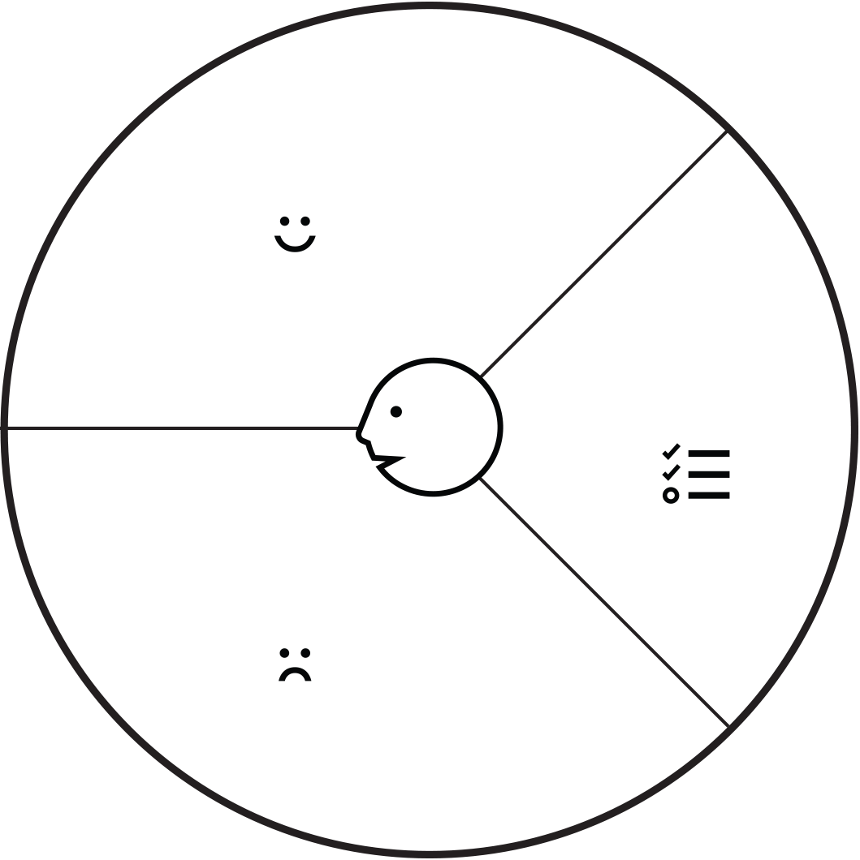
Gain
You will never feel lazy because have the motivate
Start new day for full fresh
Customer Job : Get up in the morning and travel to the workplace
Have some person wake up and motivate you every morning.
You don’t late in the morning.
You have person who prompt take you to the workplace.
Background
Many people want get up in the early but fight with laziness in everyday for wake up
Travel in the morning make easy to accident because already get up but not feel freshy.
Pain
Make you feel full sleep in the house
Make your car or your bike don’t use any more.

